Slide 1
Wonder Wheel
Ver 1.0

Slide 2
Wonder Wheel
Let’s get this stuff evil.
Main Goal:
Keep player stick to the game
Player get free chance of spin at every certain time (5min,10min,20min,1hour)
The reward is increase at every certain time
Potential monetization chance
Player can pay to spin the wheel

Slide 3
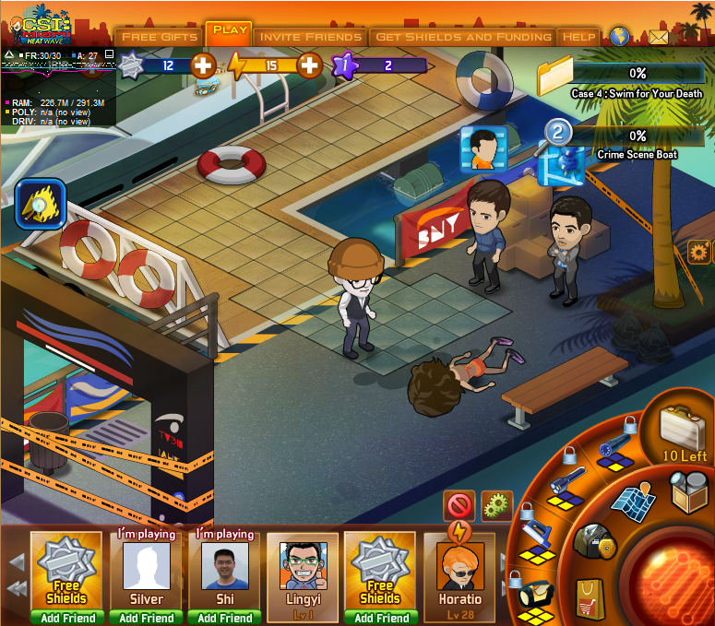


UI:1 Free Spin is ready
Free Spin!

Slide 4
UI:1 Free Spin is ready
Free Spin!
Click to play wonder wheel and earn free items!

Slide 5
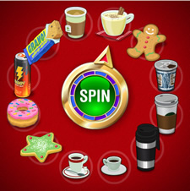
UI:1 Free Spin is ready
Wonder Wheel
X
Today’s Free Spins: 3 Left
Spin

Slide 6
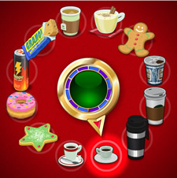
UI:1 Free Spin is ready
Wonder Wheel
X
Today’s Free Spins: 2 Left

Slide 7
UI:1 Free Spin is ready
Wonder Wheel
X
Congrats! You’ve won:
Share
Spin Again: 2

Slide 8
UI:2 Waiting for cooling down
Next Spin in 5m59s

Slide 9
UI:2 Waiting for cooling down
Next Spin in 5m59s
Click to play wonder wheel and earn free items!

Slide 10
UI:2 Waiting for cooling down
Wonder Wheel
X
Today’s Free Spins: 1 Left
Next Spin in: 115 m 58 s
Spin Again: 2

Slide 11
UI:3 Free spin is used up
Come back tomorrow !

Slide 12
UI:3 Free spin is used up
Wonder Wheel
X
Today’s Free Spins: 0 Left
Come back and spin tomorrow
Spin Again: 10

Slide 13
Wheel Settings
Spins | 1st spin | 2nd spin | >2 spin
Cooling down | 5 min | 120 min | None
Spin Price | 1 Shields | 2 Shields | 10 Shields
Wheel type | 1 | 2 | 3
Wheel Type | 1 | 2 | 3
Lesser reward 1 | x
Lesser reward 2 | x | x
Lesser reward 3 | x | x | x
Middle reward 1 | x | x | x
Middle reward 2 | x | x | x
High reward |  | x | x
Premium reward |  |  | x

